Slide 1




Arnaud Delorme
University of California, San Diego
CerCo CNRS, Toulouse
Notes:
.

Slide 2
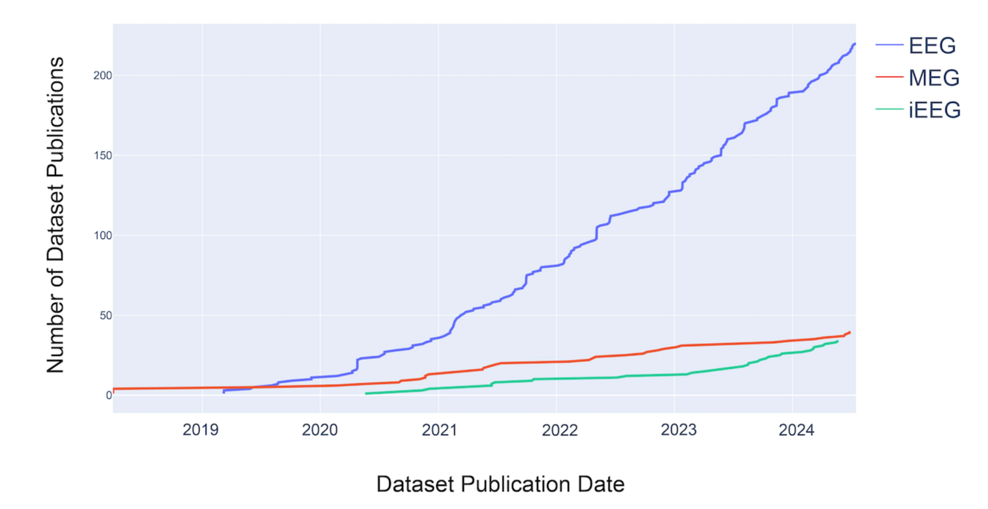
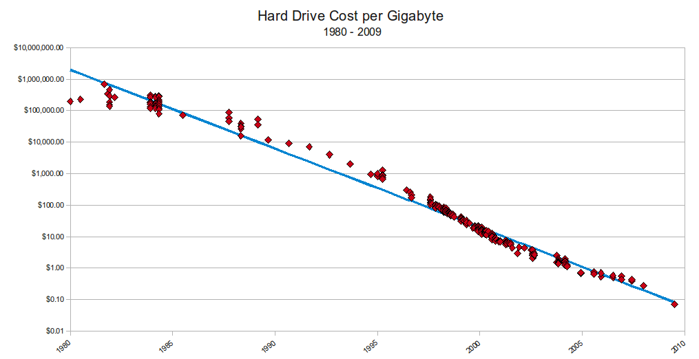
Why is sharing increasing?
https://mkomo.com/assets/hd-cost-graph.png
Cost of storage is low and there are plenty of free repository
Grant agencies do not want to spend million to acquire data and then throw it away
Issue with replicability in Science. Journal require you to post data.
Standard pipelines and AI are in the air

Slide 3
Open Data
Findable
Data and supplementary materials have sufficiently rich metadata and a unique and persistent identifier.
Accessible
Data is deposited in a trusted repository.
Interoperable
(Meta)data uses a formal, shared, and broadly applicable language or format.
Reusable
Data is described with clear and understandable attributes.
Anonymized.
There should be a clear and acceptable license for re-use.
https://www.force11.org/group/fairgroup/fairprinciples

Slide 4
Open Data - BIDS
Findable
Data and supplementary materials have sufficiently rich metadata and a unique and persistent identifier.
Accessible
Data is deposited in a trusted repository.
Interoperable
(Meta)data uses a formal, shared, and broadly applicable language or format.
Reusable
Data is described with clear and understandable attributes.
Anonymized.
There should be a clear and acceptable license for re-use.
https://www.force11.org/group/fairgroup/fairprinciples

Slide 5

What is BIDS?
BIDS is a way to organize your existing raw data
To improve consistent and complete documentation
To facilitate re-use by your future self and others
BIDS is not
A new file format
A search engine
A data sharing tool

Slide 6




Slide 7
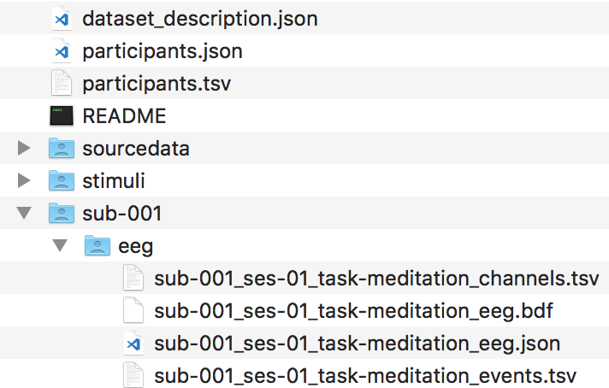
BIDS-EEG

Slide 8
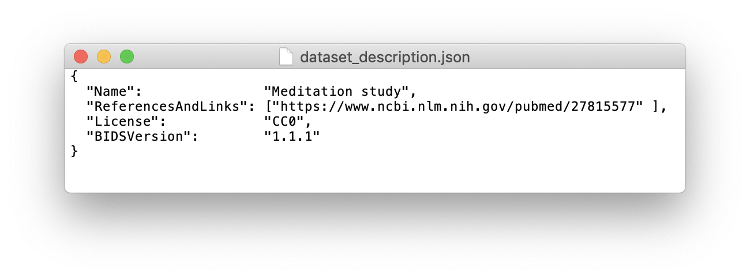
BIDS-EEG
▶︎ description of dataset in JSON format

Slide 9
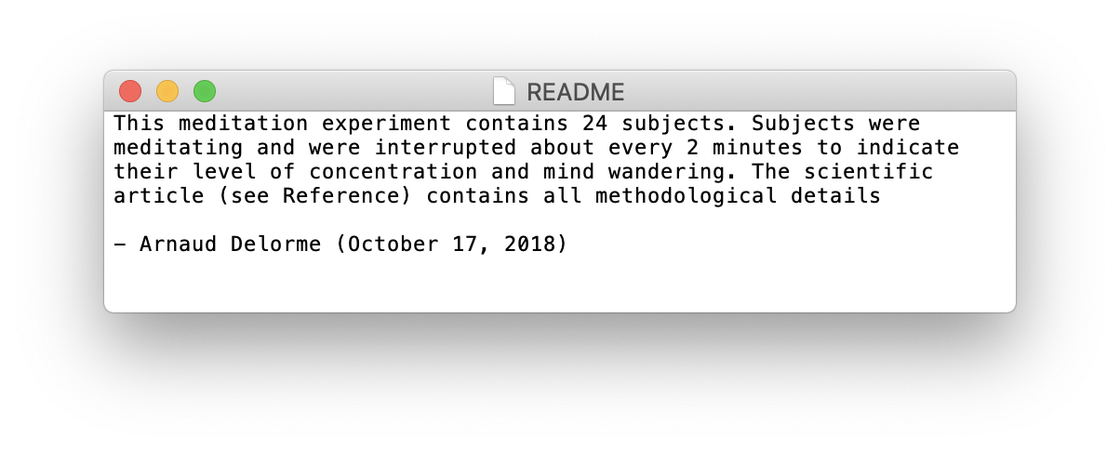
BIDS-EEG
▶︎ description of dataset in JSON format
▶︎ readme file for users

Slide 10
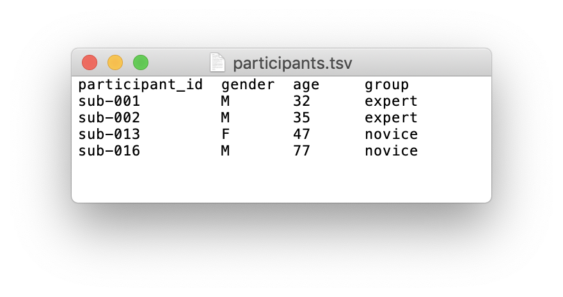
BIDS-EEG
▶︎ description of dataset in JSON format
▶︎ readme file for users
▶︎ participants table files in tab delimited format

Slide 11
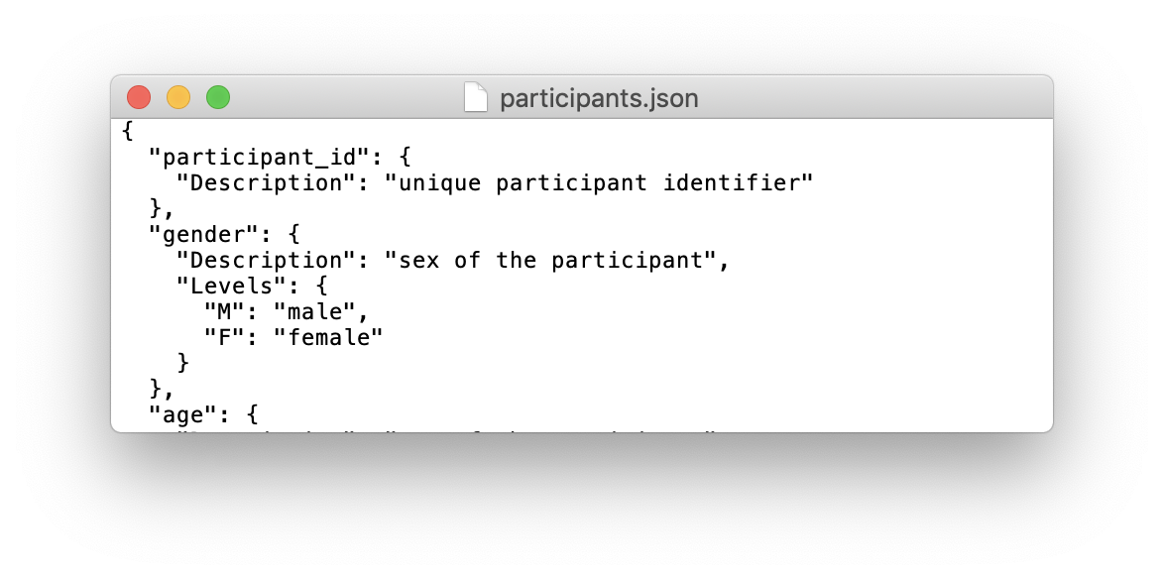
BIDS-EEG
▶︎ description of dataset in JSON format
▶︎ readme file for users
▶︎ participants table files in tab delimited format
▶︎ description of participants table file columns (above)

Slide 12
BIDS-EEG
▶︎ description of dataset in JSON format
▶︎ readme file for users
▶︎ participants table files in tab delimited format
▶︎ description of participants table file columns (above)
▶︎ original raw data if converted to a supported format
▶︎ original stimuli (sound files and images)
▶︎ anonymized subject 1 folder

Slide 13
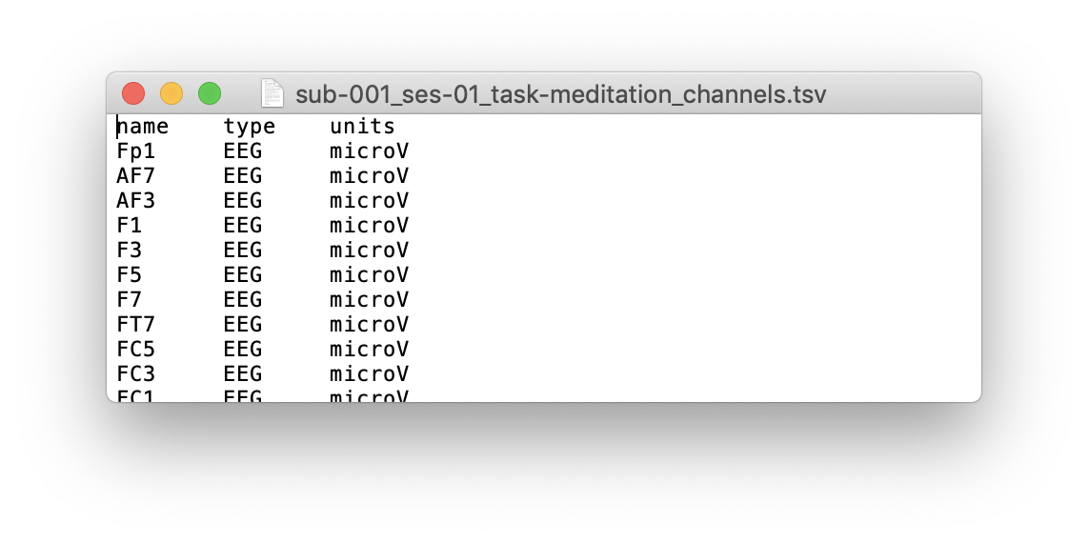
BIDS-EEG
▶︎ description of dataset in JSON format
▶︎ readme file for users
▶︎ participants table files in tab delimited format
▶︎ description of participants table file columns (above)
▶︎ original raw data if converted to a supported format
▶︎ original stimuli (sound files and images)
▶︎ anonymized subject 1 folder
▶︎ file describing channels

Slide 14
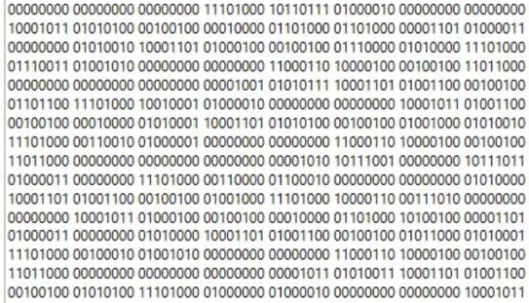
BIDS-EEG
▶︎ description of dataset in JSON format
▶︎ readme file for users
▶︎ participants table files in tab delimited format
▶︎ description of participants table file columns (above)
▶︎ original raw data if converted to a supported format
▶︎ original stimuli (sound files and images)
▶︎ anonymized subject 1 folder
▶︎ file describing channels
▶︎ raw EEG data file (not all raw formats are possible)

Slide 15
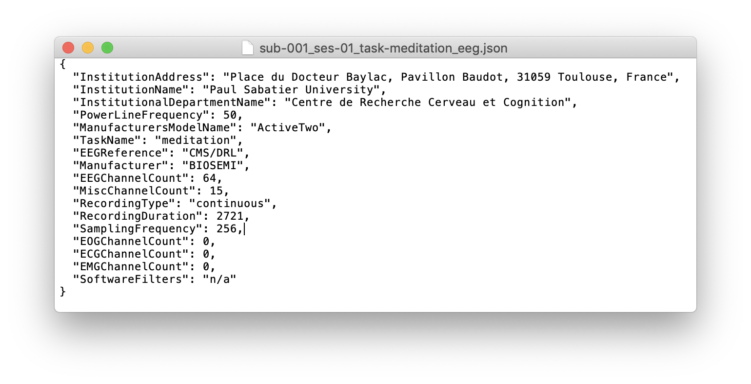
BIDS-EEG
▶︎ description of dataset in JSON format
▶︎ readme file for users
▶︎ participants table files in tab delimited format
▶︎ description of participants table file columns (above)
▶︎ original raw data if converted to a supported format
▶︎ original stimuli (sound files and images)
▶︎ anonymized subject 1 folder
▶︎ file describing channels
▶︎ raw EEG data file (not all raw formats are possible)
▶︎ amplifier and recording information

Slide 16
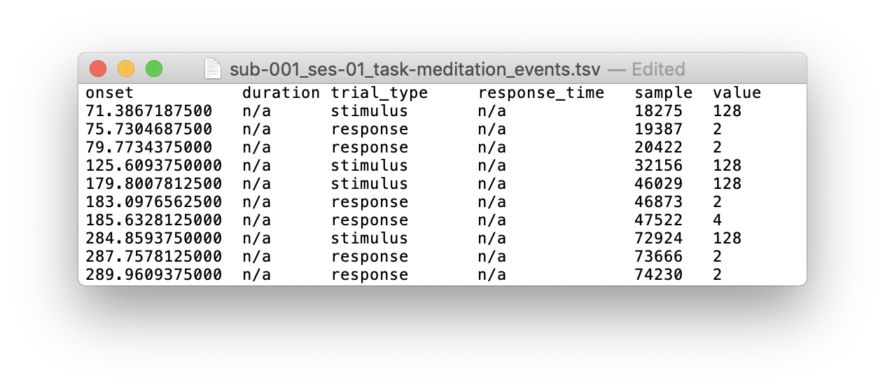
BIDS-EEG
▶︎ description of dataset in JSON format
▶︎ readme file for users
▶︎ participants table files in tab delimited format
▶︎ description of participants table file columns (above)
▶︎ original raw data if converted to a supported format
▶︎ original stimuli (sound files and images)
▶︎ anonymized subject 1 folder
▶︎ file describing channels
▶︎ raw EEG data file (not all raw formats are possible)
▶︎ amplifier and recording information
▶︎ events in tabular format
BIDS specification:
https://bids-specification.readthedocs.io/en/latest/
This example:
https://openneuro.org/datasets/ds001787

Slide 17
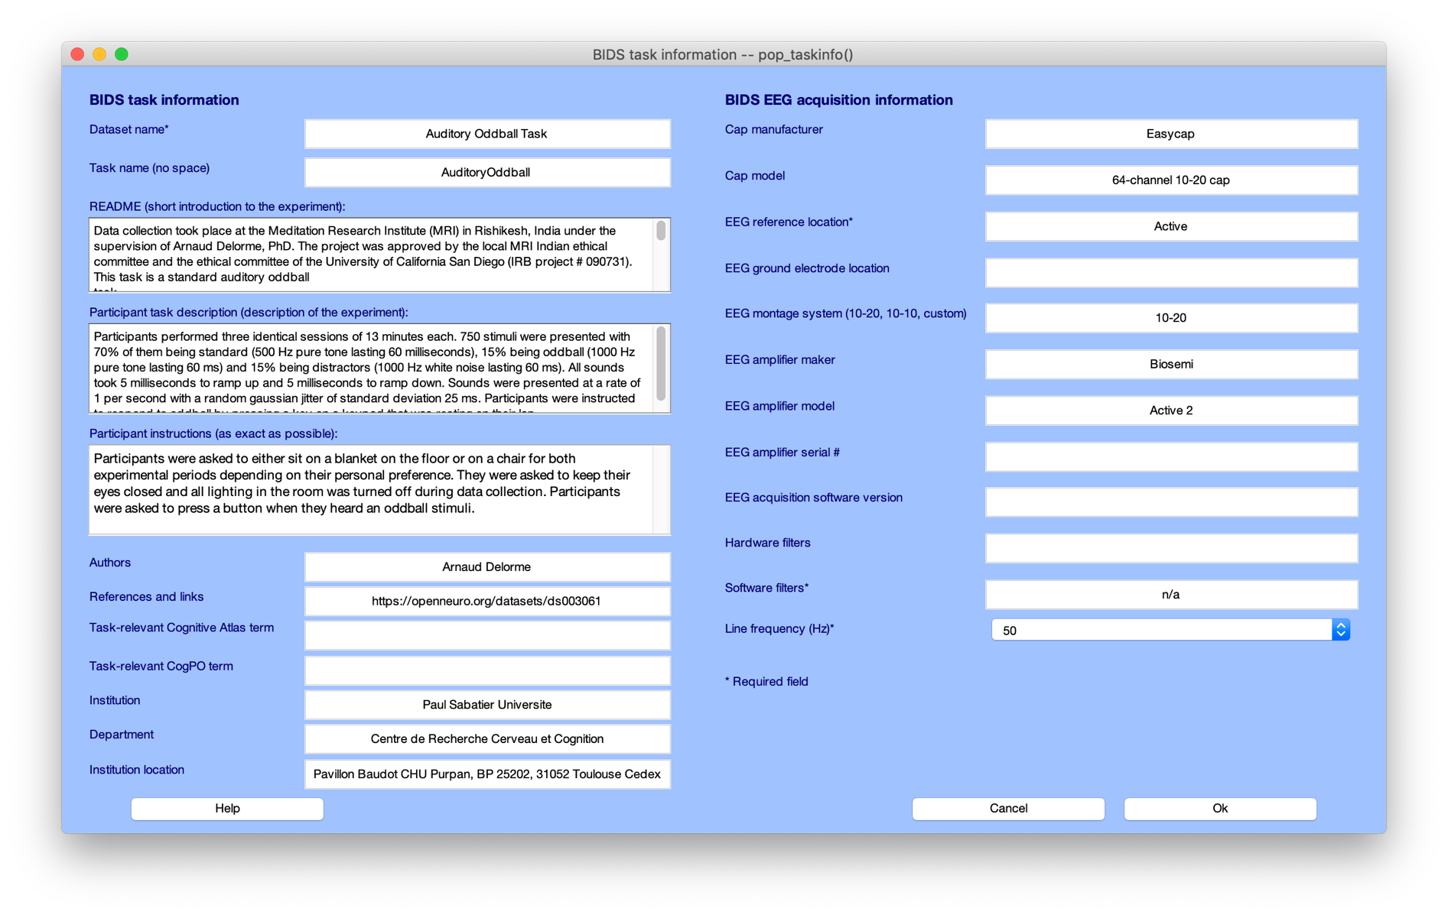
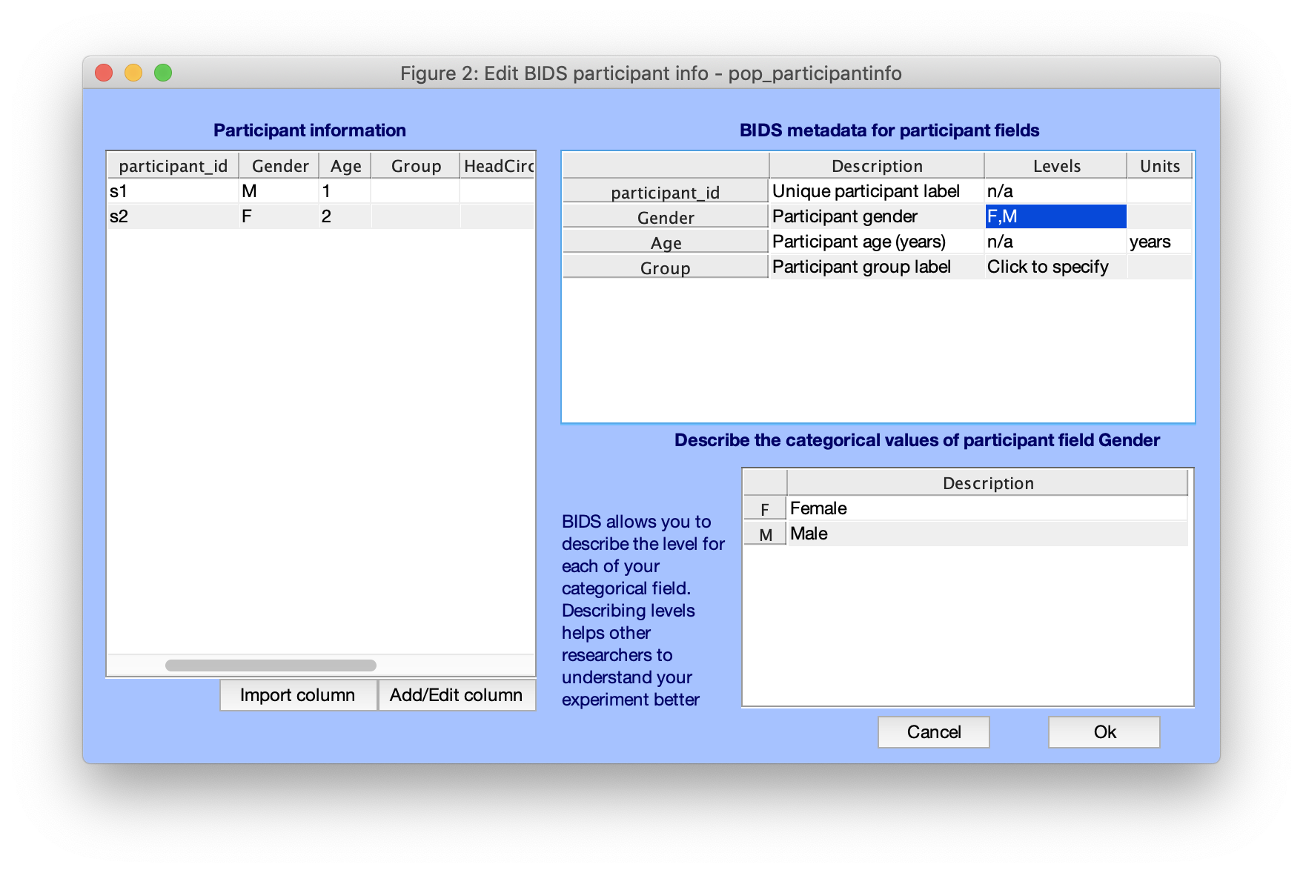
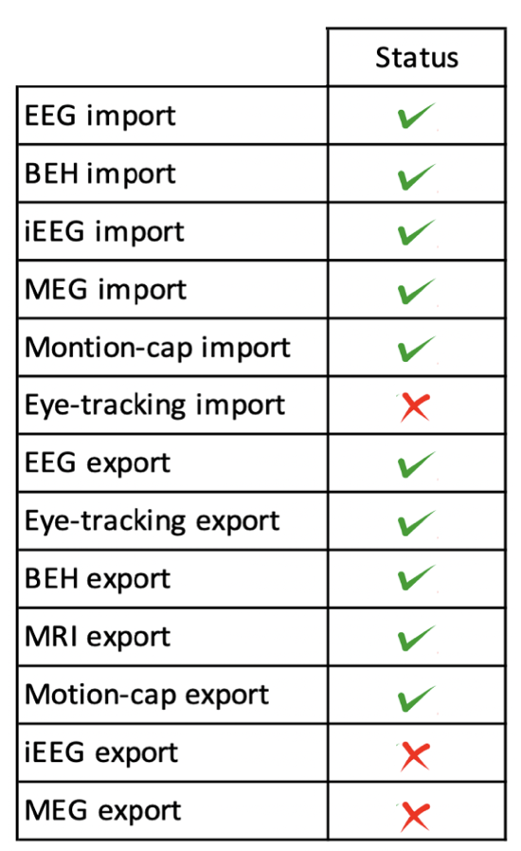
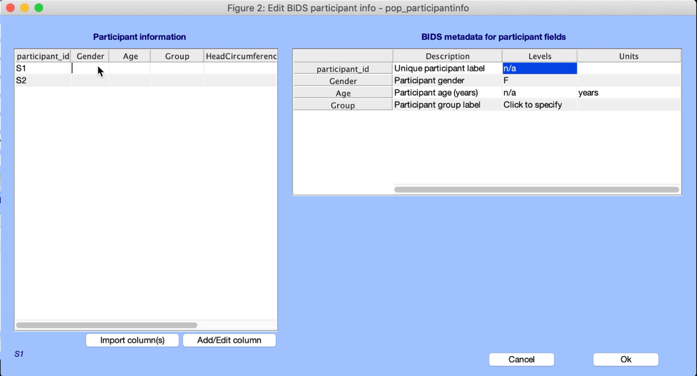
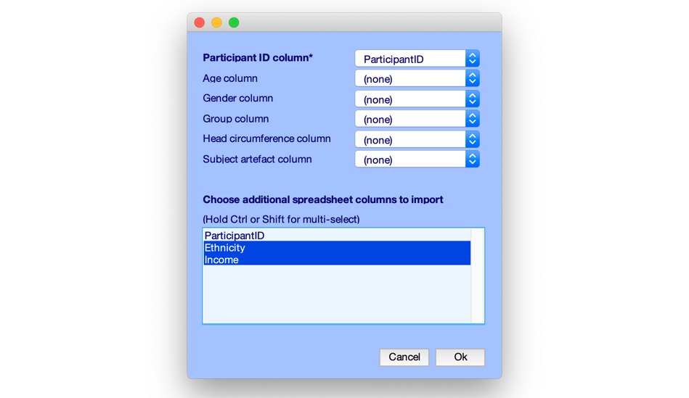
EEG-BIDS (BIDS export/import)

Slide 18
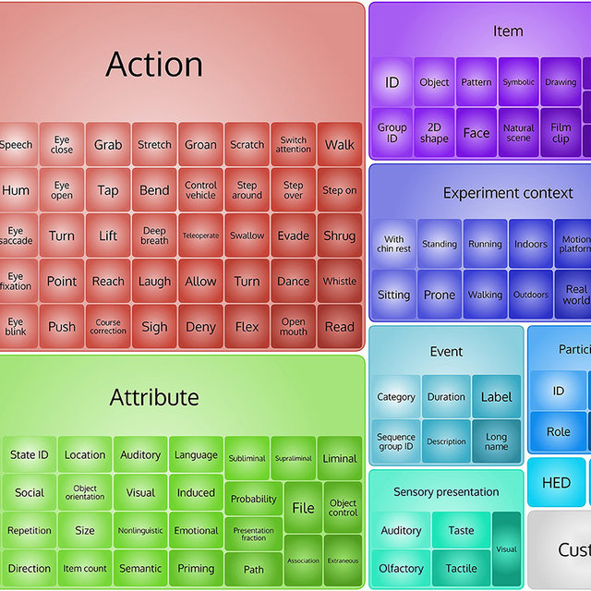
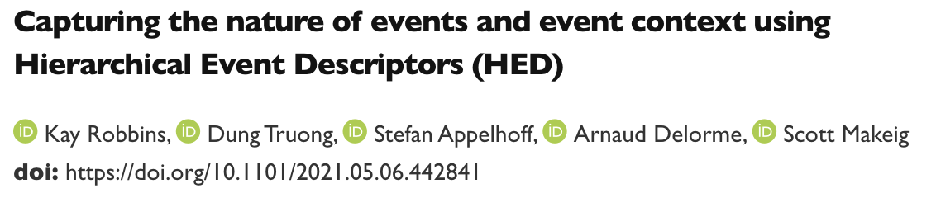
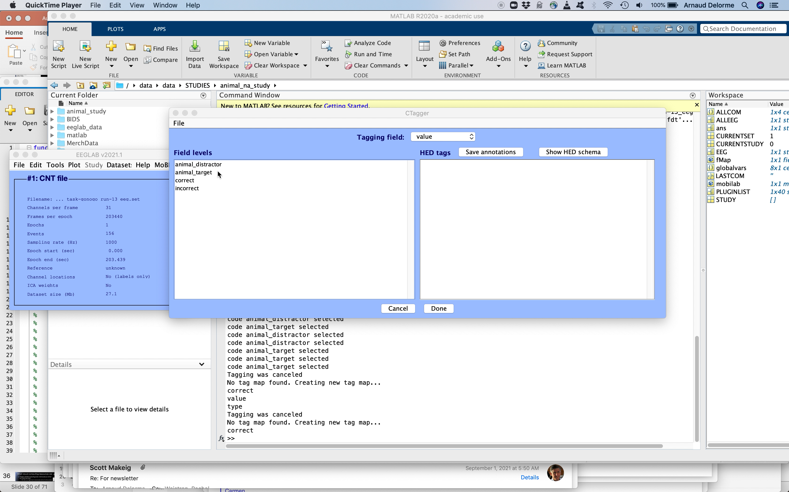
Task and event details

Slide 19



TOOLS
https://bids.neuroimaging.io/benefits.html

Slide 20
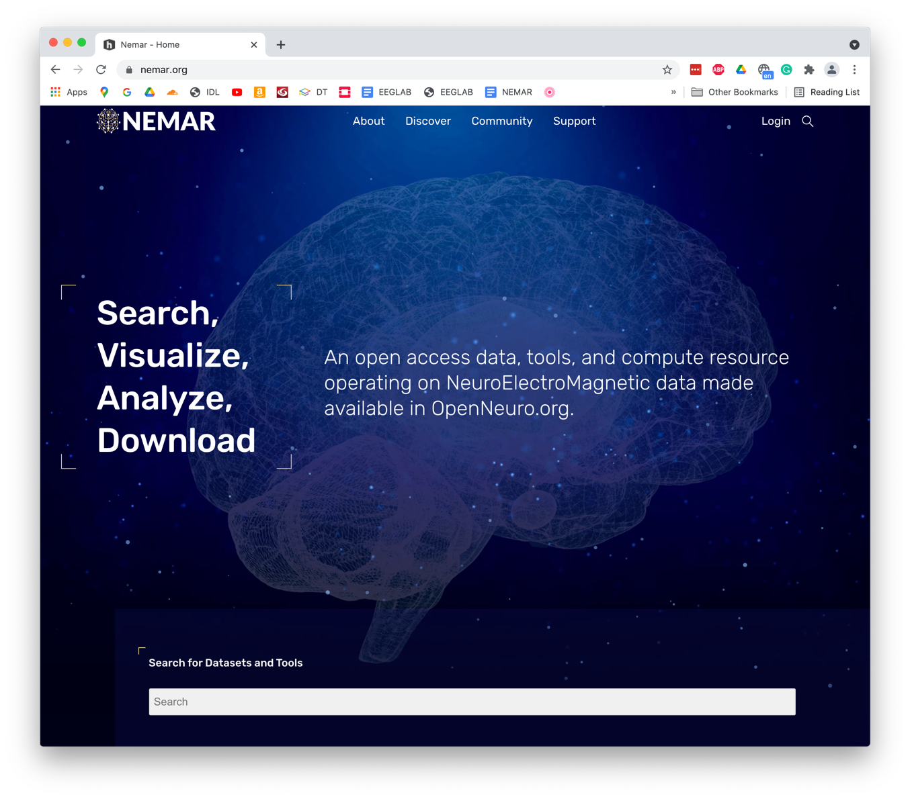
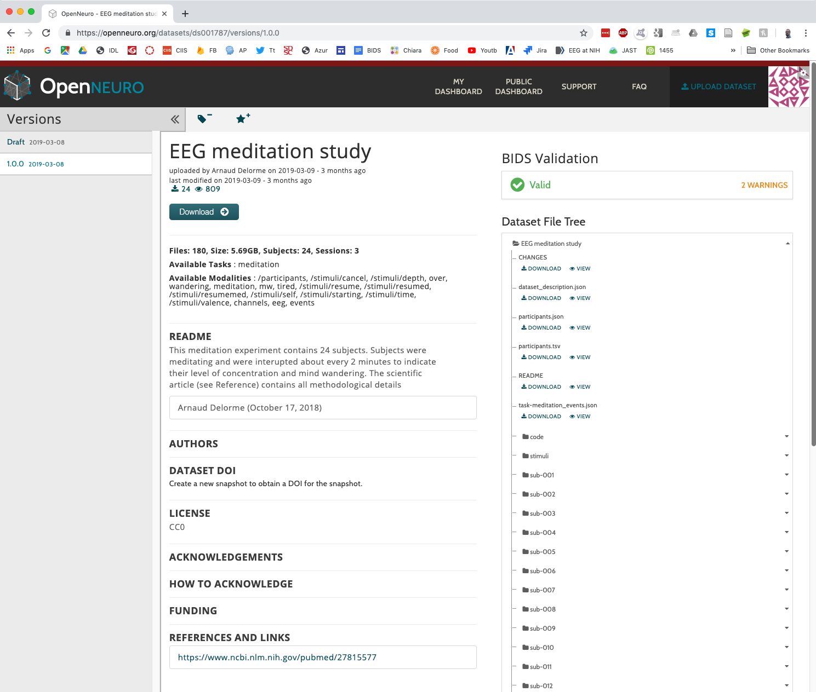
Neuroelectromagnetic Data Archive and Tools Resource

Slide 21
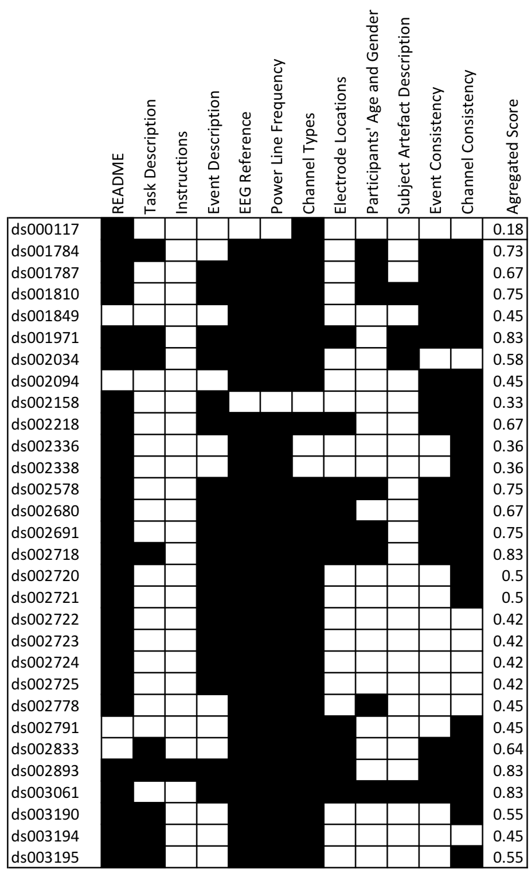
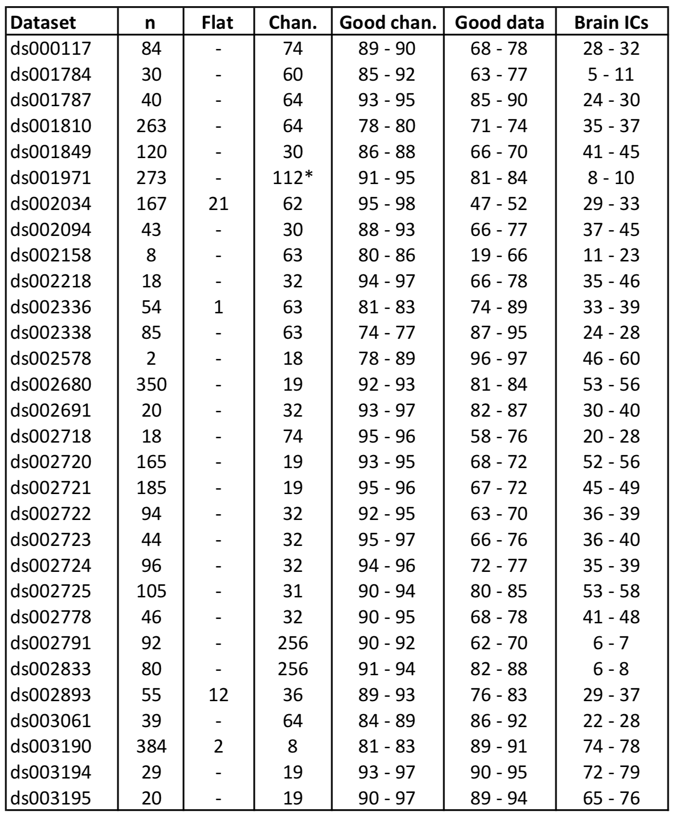
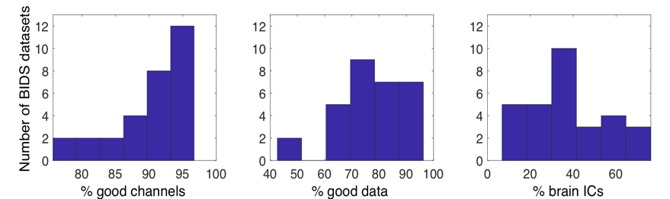
Delorme et al. (2021) Tools for Importing and Evaluating BIDS-EEG Formatted Data. NER IEEE conference on biomedical engeeneering. May, online.

Slide 22
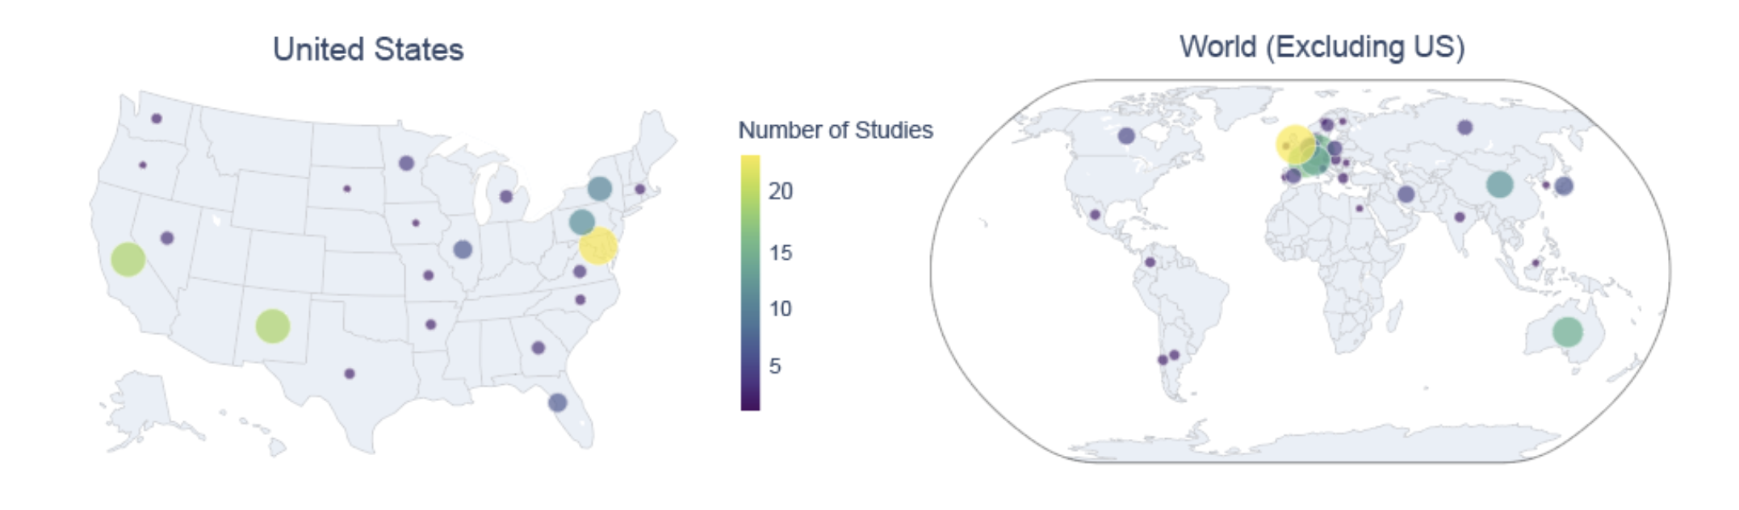

Brandmeyer, T. … Delorme, A. (2024). Neuroelectromagnetic Data Archive and Repository - Open Source Platform Analysis. Manuscript submitted for publication.

Slide 23
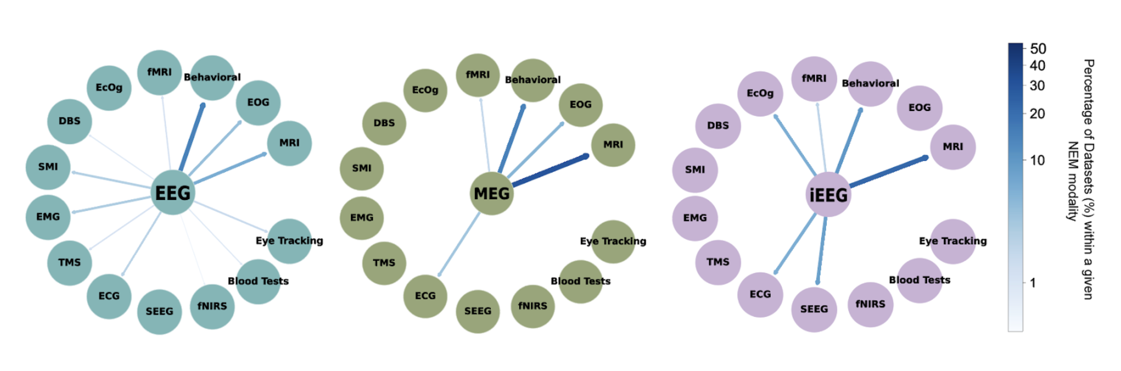

Slide 24
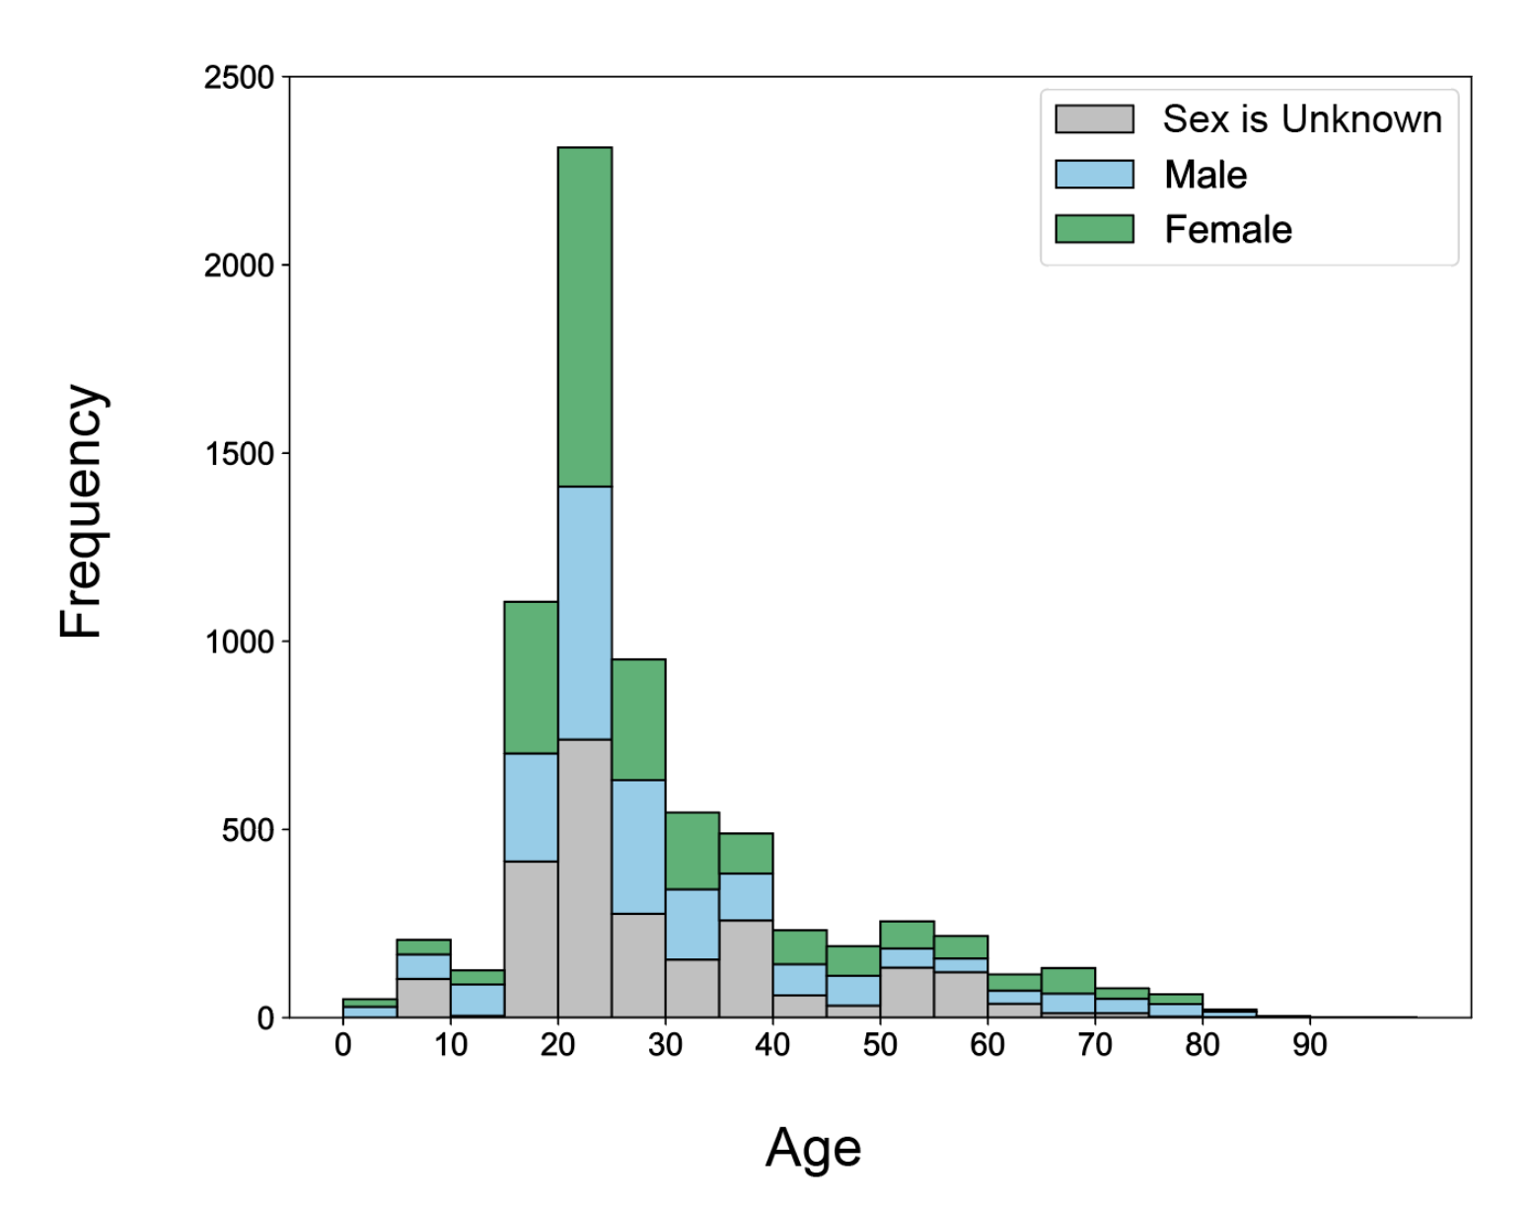
Brandmeyer, T. … Delorme, A. (2024). Neuroelectromagnetic Data Archive and Repository - Open Source Platform Analysis. Manuscript submitted for publication.

Slide 25
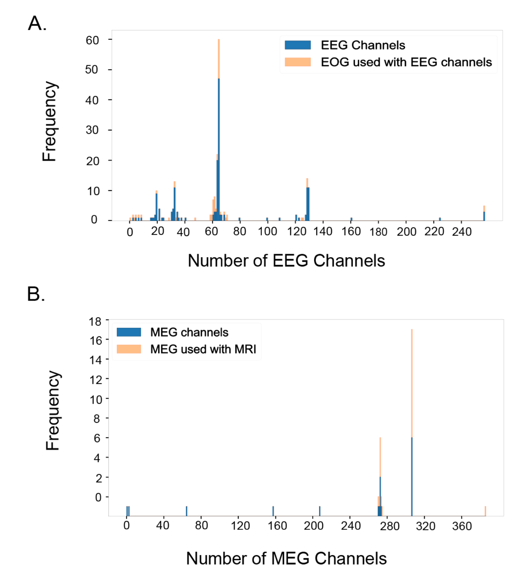

Slide 26
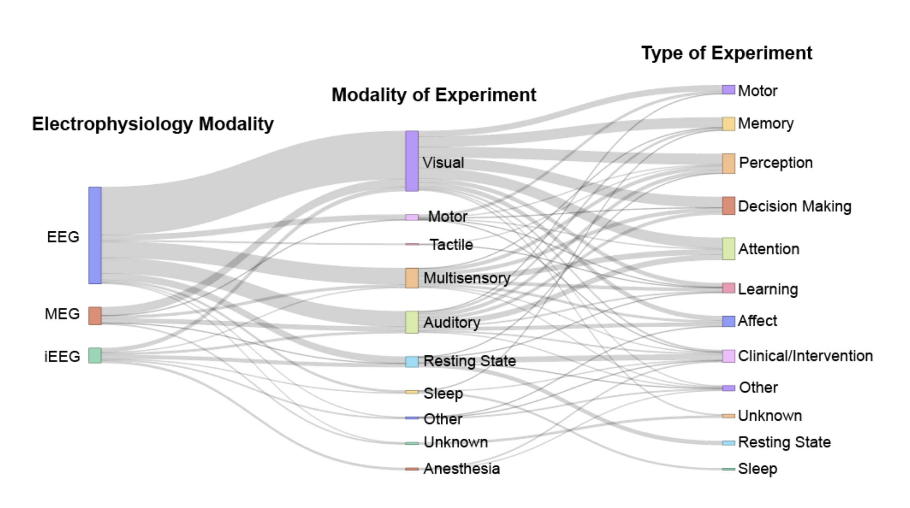
Brandmeyer, T. … Delorme, A. (2024). Neuroelectromagnetic Data Archive and Repository - Open Source Platform Analysis. Manuscript submitted for publication.

Slide 27
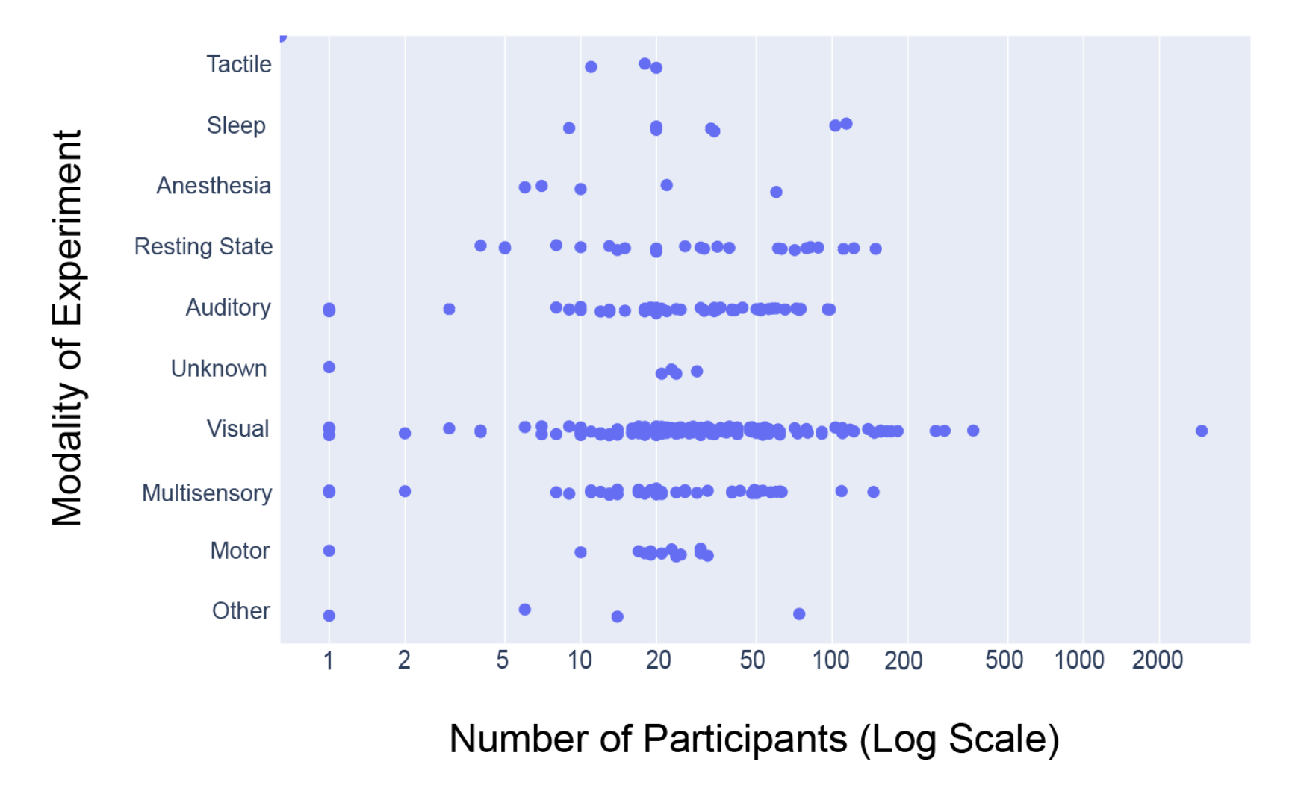
Brandmeyer, T. … Delorme, A. (2024). Neuroelectromagnetic Data Archive and Repository - Open Source Platform Analysis. Manuscript submitted for publication.

Slide 28
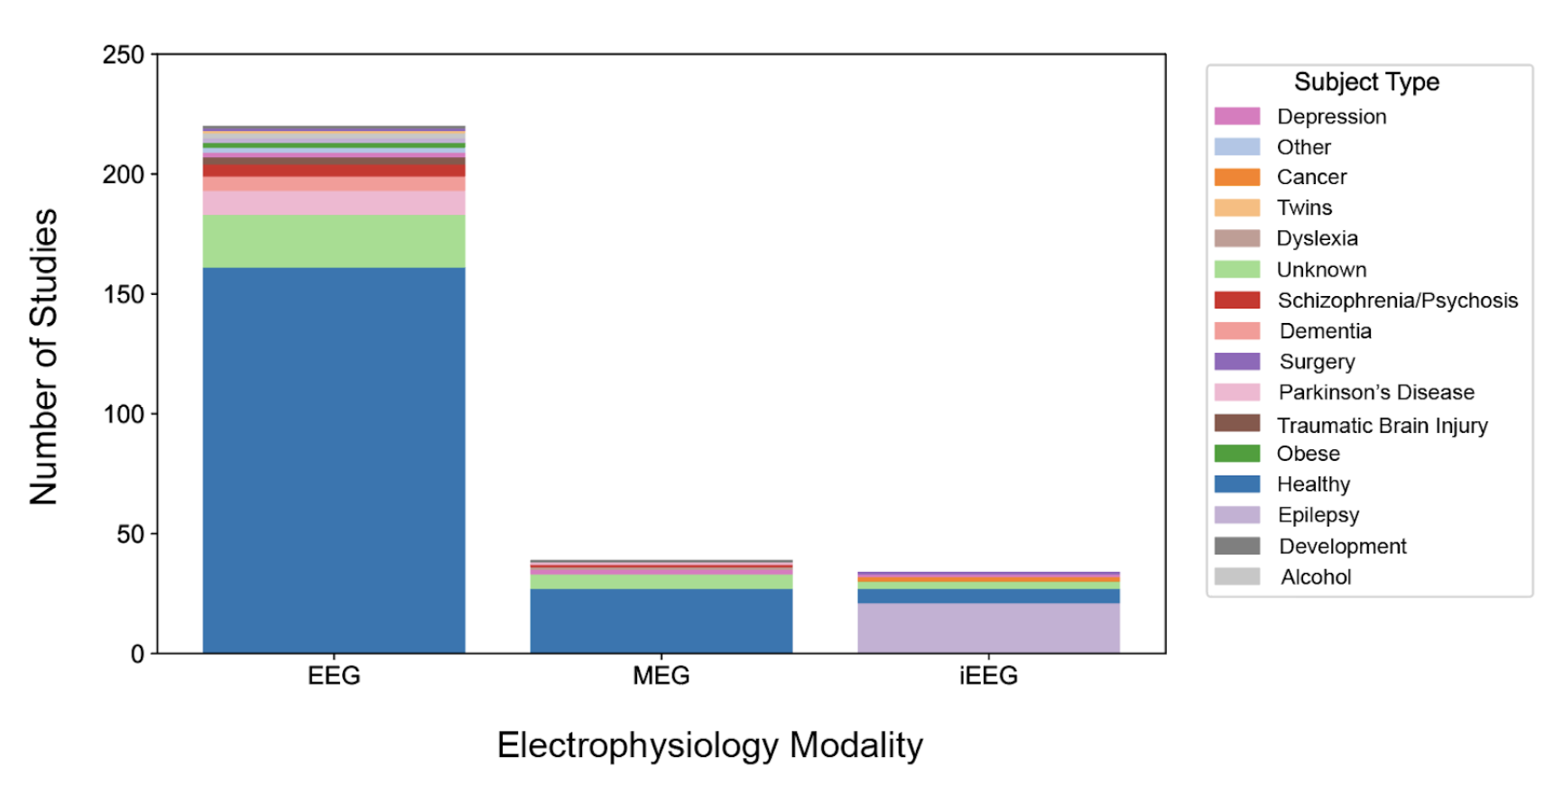
Brandmeyer, T. … Delorme, A. (2024). Neuroelectromagnetic Data Archive and Repository - Open Source Platform Analysis. Manuscript submitted for publication.

Slide 29

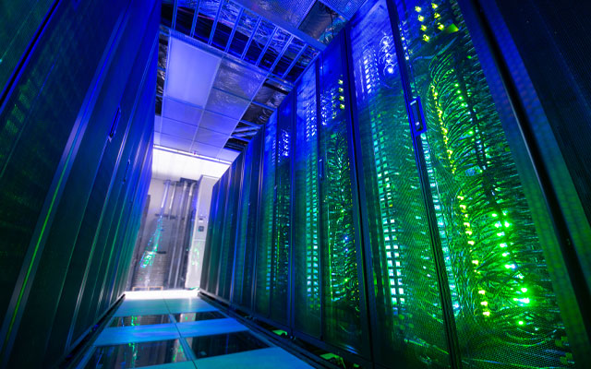

Expanse:
208 GPU Nodes
V100 (32 GB SMX2)
No wait
48-hour max
GPU Nodes: 208 NVIDIA V100 GPUs (32 GB)
CPU Nodes: Intel Xeon (x40)
Memory per Node: 728 compute nodes
(128 cores and 256 Gb of RAM)

Slide 30



Computational resources
EEGDash
Free for all (non commercial)

Slide 31

